Slide 1

MuleSoft Training

Slide 2
WHAT IS ESB
An Enterprise Service Bus (ESB) is fundamentally an architecture. It is a set of rules and principles for integrating numerous applications together over a bus-like infrastructure.
The core concept of the ESB architecture is that you integrate different applications by putting a communication bus between them and then enable each application to talk to the bus.
This decouples systems from each other, allowing them to communicate without dependency on or knowledge of other systems on the bus.
The concept of ESB was born out of the need to move away from point-to-point integration, which becomes brittle and hard to manage over time.
Point-to-point integration results in custom integration code being spread among applications with no central way to monitor or troubleshoot.

Slide 3
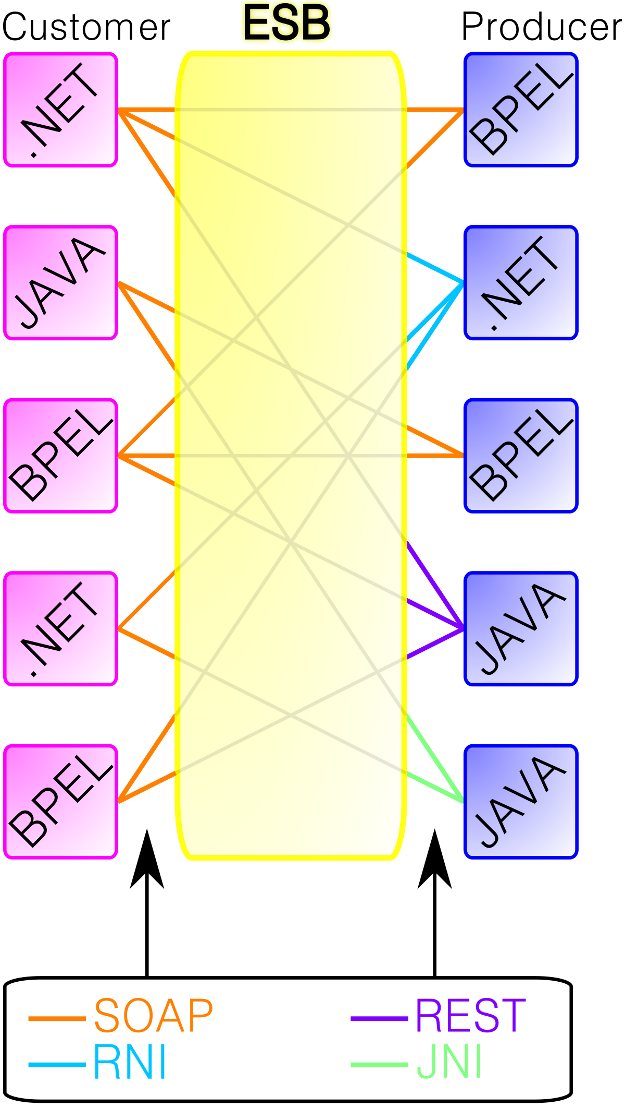

Slide 4
What is mulesoft
MuleSoft is a data integration platform built to connect a variety of data sources and applications
MuleSoft provides integration software for connecting applications, data and devices.
Mulesoft’s Anypoint Platform of integration products is designed to integrate software as a service (SaaS), on-premises software, legacy systems, and more.
The company originally provided middleware and messaging.
later expanded to provide an integration platform as a service (iPaaS) approach for companies through its main product, Anypoint Platform.
MuleSoft's Anypoint Platform includes various components such as Anypoint Design Center, which allows API developers to design and build APIs
Anypoint Exchange, a library for API providers to share APIs, templates, and assets
Anypoint Management Center, a centralized web interface to analyze, manage, and monitor APIs and integrations.
MuleSoft also offers the Mule runtime engine, a runtime solution for connecting enterprise applications on-premises and to the cloud

Slide 5
HISTORY
Ross Mason and Dave Rosenberg founded MuleSource in 2006.
The company changed the name to MuleSoft in 2009.
In April 2013, the startup announced $37 million in Series E financing in a round led by New Enterprise Associates
In April 2013, MuleSoft acquired ProgrammableWeb, a website used by developers to help build web, mobile and other connected applications through APIs.
In 2016, MuleSoft was ranked #20 on the Forbes Cloud 100 list.
On May 2, 2018, Salesforce acquired Mulesoft for $6.5 billion
As of August 2019, MuleSoft has over 1,400 employees and 1,600 customers
The "mule" in the name comes from the drudgery, or "donkey work," of data integration that the platform was created to escape

Slide 6

training
Online training : https://training.mulesoft.com/
Signup to your account
Continue…

Slide 7
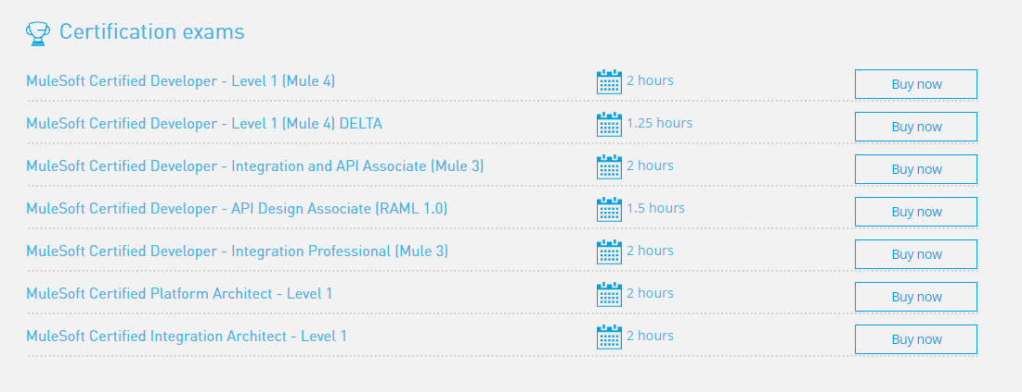
certification

Slide 8

Why to Choose Mulesoft
Rapid Development Environment
Mulesoft IDE is Eclipse base Anypoint Studio which enables developer to rapidly develop integration application by dragging and dropping components. Anypoint studio integrates with other commonly tools like Maven and GitHub. Anypoint studio has built-in Mule runtime serve and application testing framework MUnit.
Built-in ready to use Features
Mulesoft comes with 120+ built-in connector which are available with Mulesoft’s Anypoint Studio or can be downloaded from Mulesoft Public Exchange. Mulesoft also provide many built-in message transformers and processors.
Community and Enterprise Editions
Mulesoft ESB comes in both community and enterprise edition. Community edition is open source which has limited feature. Enterprise edition has additional features and need license. Choice can be made on the basis of cost consideration.
Dataweave Language
DataWeave is the MuleSoft expression language for accessing and transforming data. It is a very powerful language for data transformation and comes with only Enterprise edition.
Cloud iPaaS Offering
Mulesoft offers Cloud integration-PaaS (Cloudhub) to deploy Mule applications on cloud. Mulesoft’s Cloudhub iPaaS also offers a verity of cloud services to build complete integration platform on cloud. Same Mule applications can be migrated to Cloud iPaas platform.

Slide 9
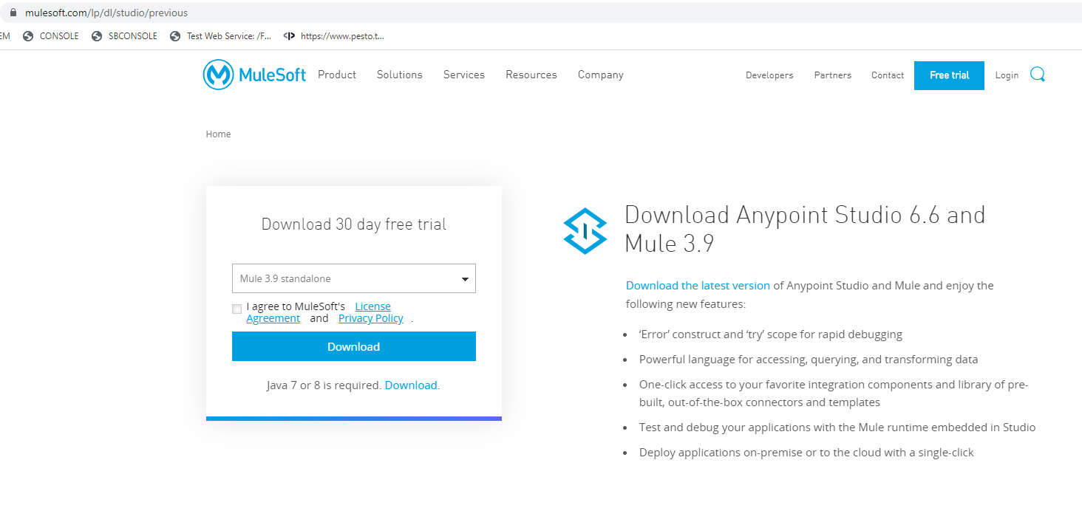
installation
https://www.mulesoft.com/lp/dl/studio/previous
Download Anypoint Studio 6.6 and Mule 3.9

Slide 10
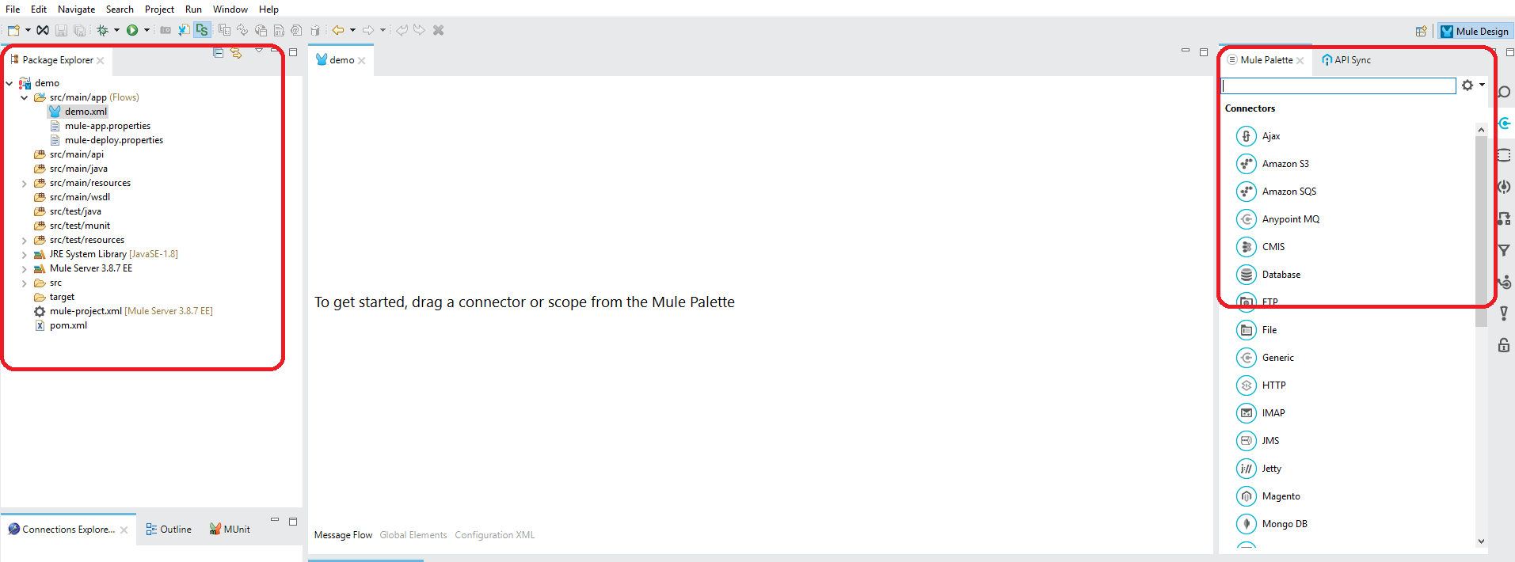
Anypointstudio

Slide 11
components
Projects appear in package explorer section
Connectors, scopes, filters .etc available in Mule Palette.
connectors: Anypoint Connectors receive or send messages between Mule and one or more external sources, such as files, databases, or Web services. Connectors can act as message sources by working as inbound endpoints, they can act as a message processor that performs an operation in the middle of a flow, or they can fall at the end of a flow and act as the recipient of the final payload data.
Ex: ActiveMQ, FTP, File, Http, JDBC connectors
Endpoints: Endpoints are used to connect flows. An endpoint is a specific channel on which a flow can send messages and from which another flow or external service can receive messages. For example, a purchasing component may receive an order request over HTTP. Once the order has been processed by the component, a JMS message may be sent over a topic to notify an auditing system, and a response can be sent back over HTTP.
Ex: HTTP Endpoint, JMS Endpoint

Slide 12
Routers: Routers (Flow Controls in Anypoint Studio) route messages to various destinations in a Mule flow. Some routers incorporate logic to analyze and possibly transform messages before routing takes place. For example, various flow controls can:
Split a message into several segments, then route each segment to a different building block.
Combine several messages into a single message before sending it to the next building block in the flow.
Reorder a list of messages before sending it to the next building block.
Evaluate a message to determine which of several possible building blocks it should be routed to next.
Broadcast the same message to multiple building blocks
Error Handling: Mule ESB provides numerous options for handling errors. Faults that occur within Mule are referred to as exceptions; when an activity in your Mule instance fails, Mule throws an exception. To manage these exceptions, Mule allows you to configure exception strategies.
Mule’s default exception strategy — which implicitly applies to all Mule applications — manages errors (i.e. thrown exceptions) in Mule flows. When your flows require more sophisticated error management, you can implement one or more exception strategies to construct precise, efficient protocols for handling errors.
From a high-level perspective, errors that occur in Mule fall into one of two categories: System Exceptions, and Messaging Exceptions.
Ex: Default Exception Strategy - Defined and implicitly applied by default to handle all messaging exceptions that are thrown in Mule applications.

Slide 13
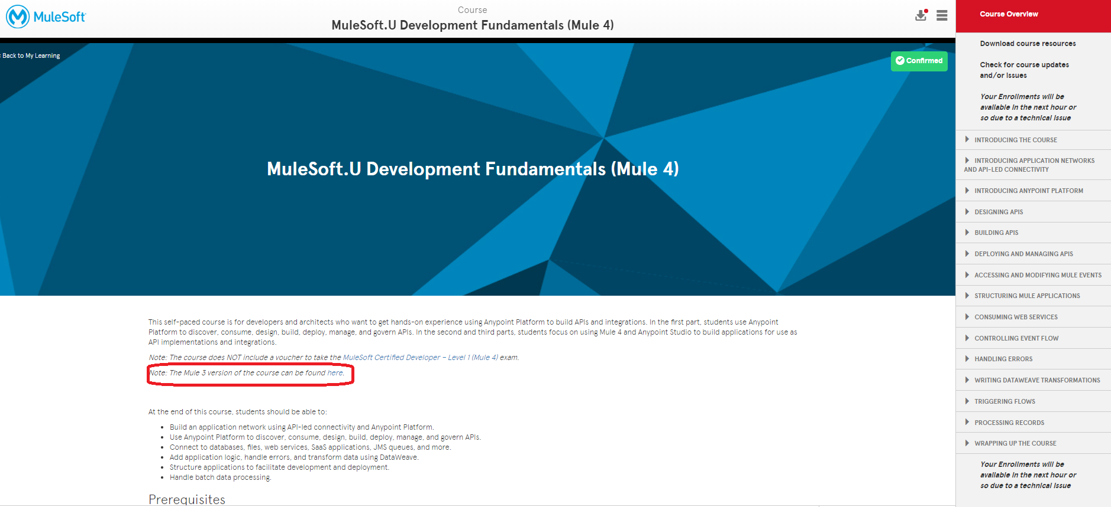

Slide 15

Thank you

